Slide 1
APNIC Hackathon 2018
Kathmandu, Nepal

Slide 2


Slide 3
Project plan
Basic idea: Pokemon Go for IPv6 :)
Identify by user-defined “funny” name to seen prefixes
Score based on unseen prefixes and undiscovered location
Score based on v6 unique prefix name
Promote new user to sign up giving some plus score
Seasonal, monthly and global scoring system
Some funny cartoon flag for every range of number
Map plotting to visualize undiscovered location
Details received score descriptions

Slide 4
Used language and methods
Python with SQLite 3
HTML, CSS, Javascript with FLASK
Postgis

Slide 5
Progress
Process flow documentation
Database design
Backend script
Random name generation
Scoring
Account check
Seen/unseen prefix & discovered/undiscovered location check
Basic frontend design
Github repository: https://github.com/insensitiveclod/pokeprefix-backend

Slide 6
Need to continue for
Elaborate on the frontend design
Complex scoring system
Map plotting for undiscovered location
Reused prefix name scoring system
Others ??

Slide 7

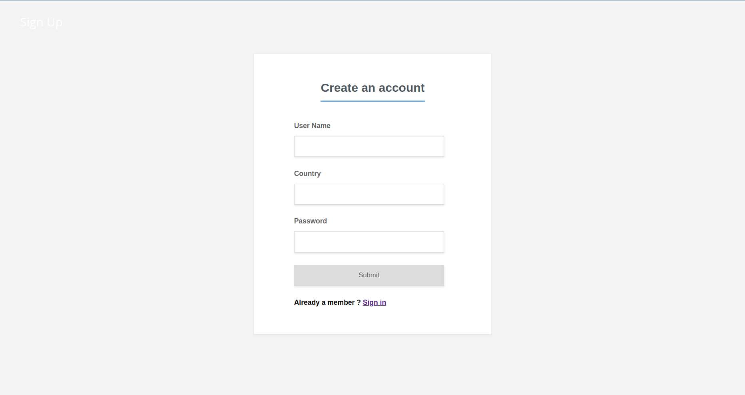


Frontend

Slide 8
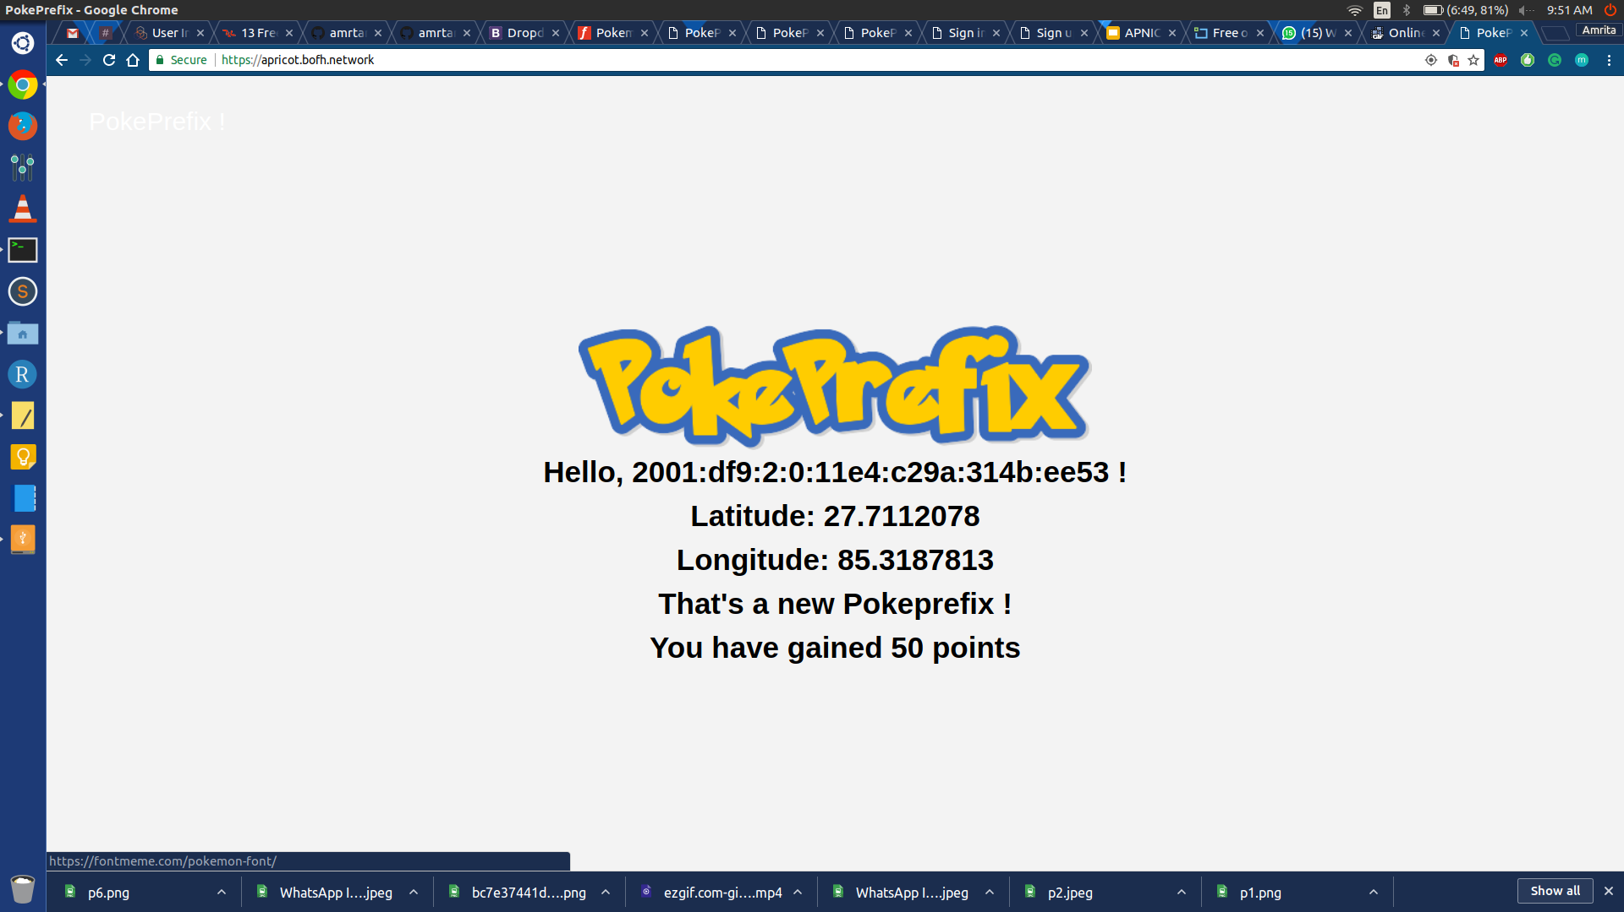

Slide 9
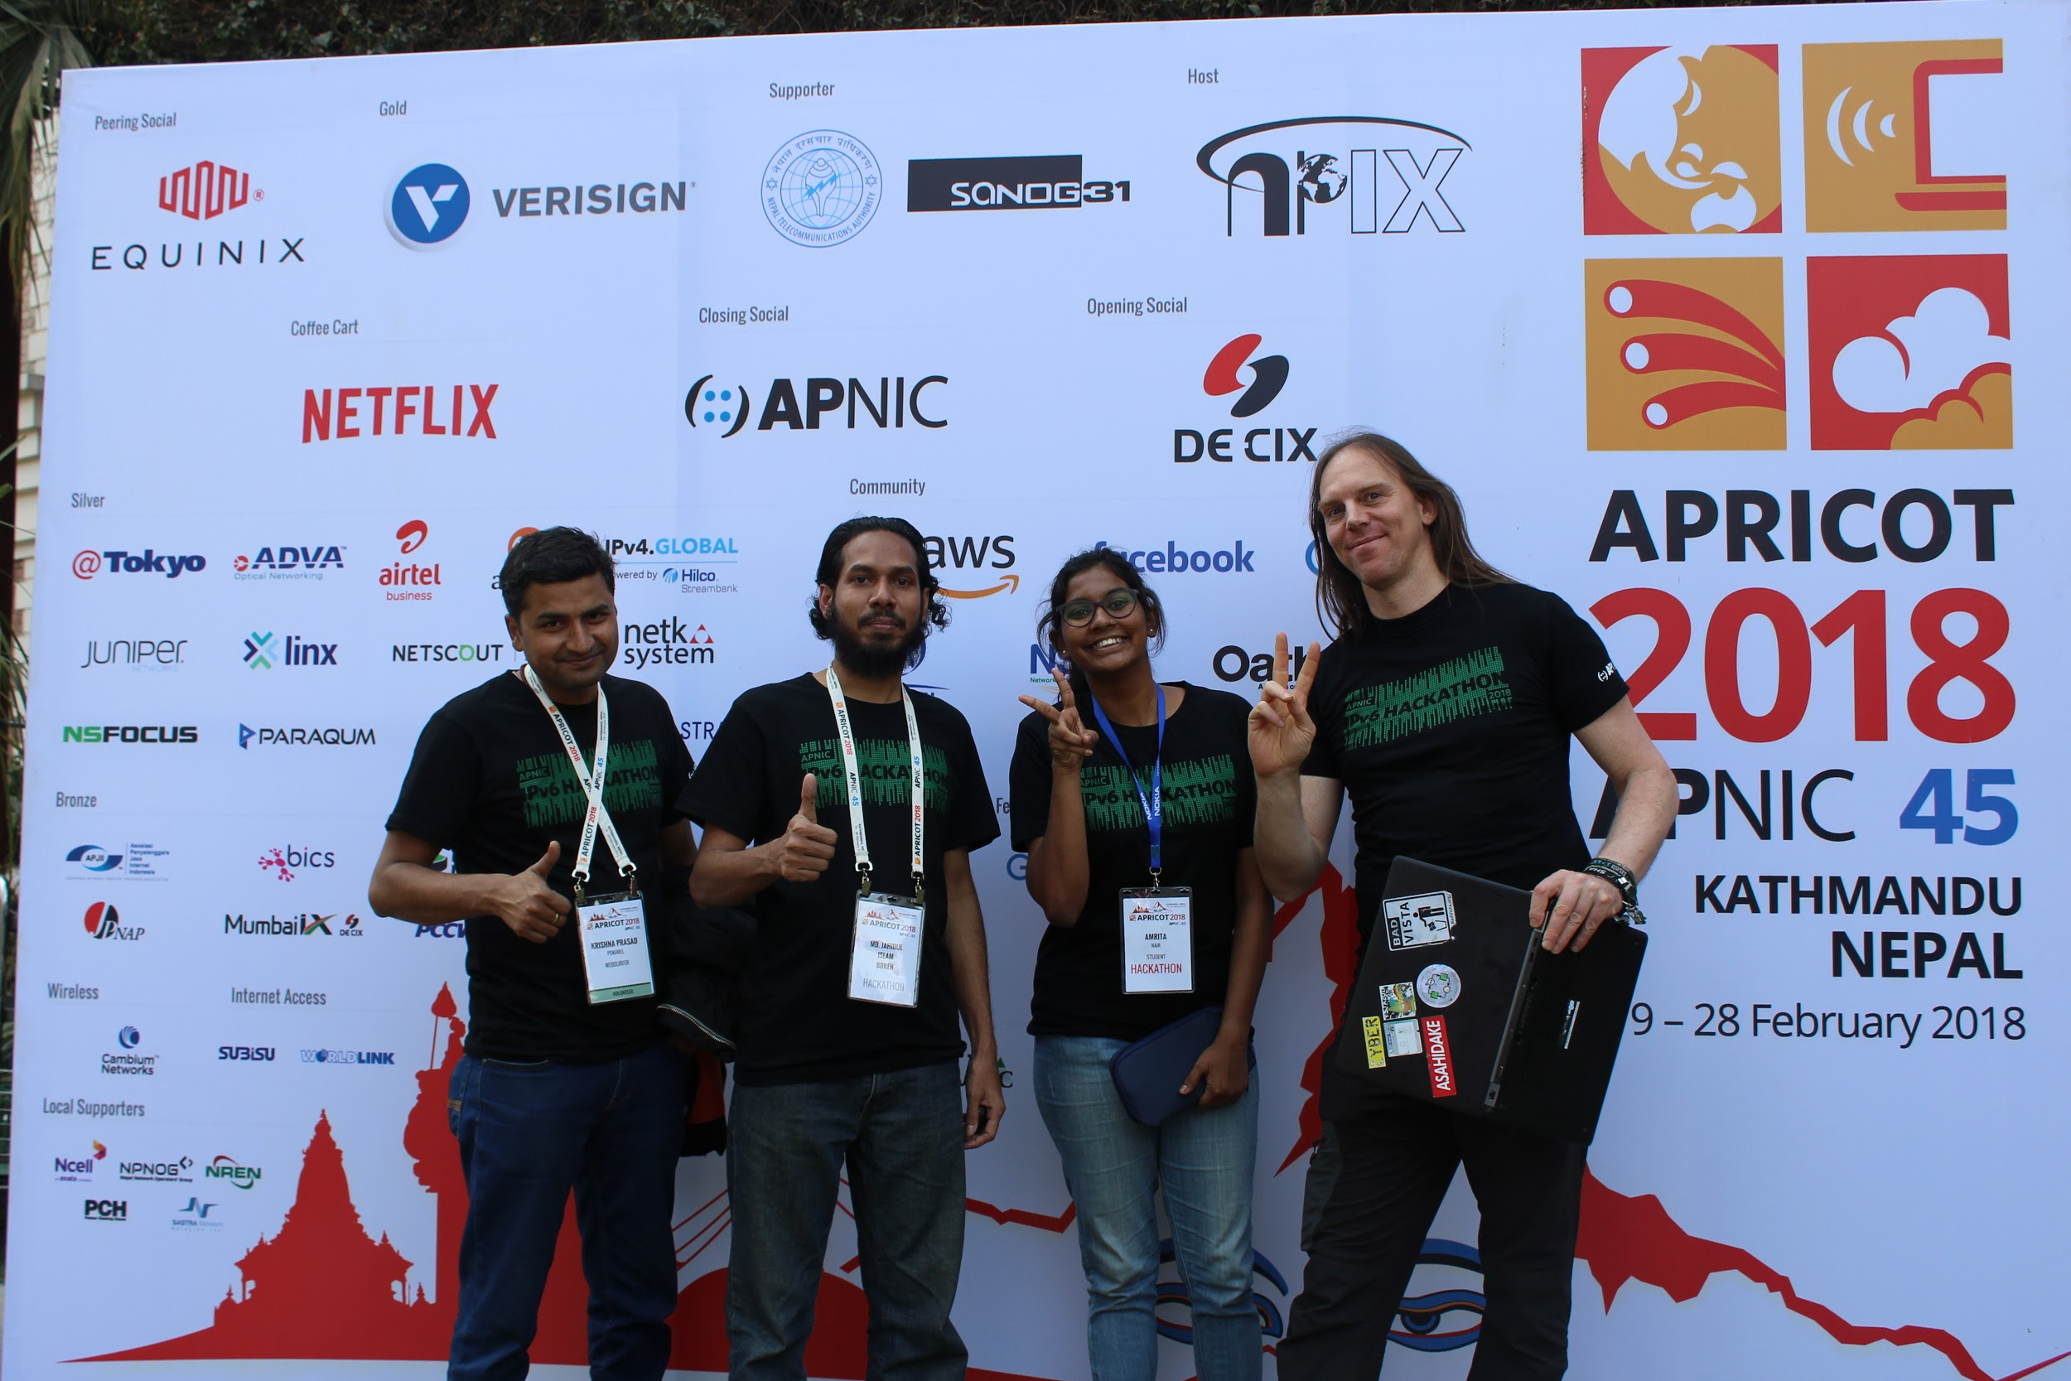
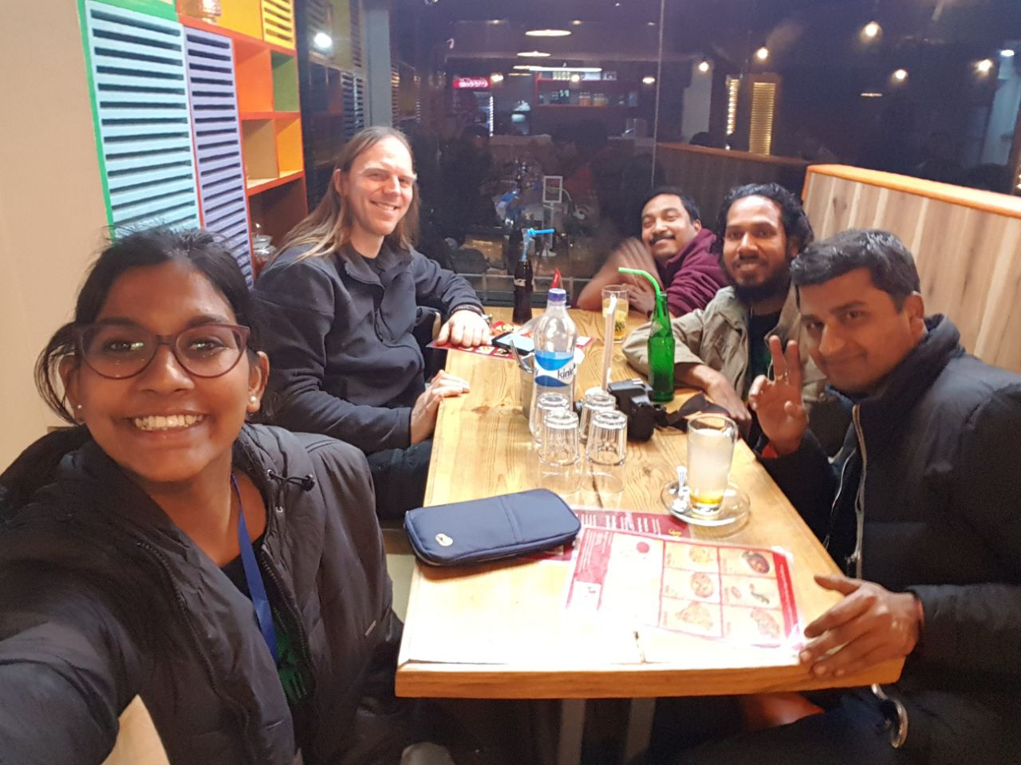
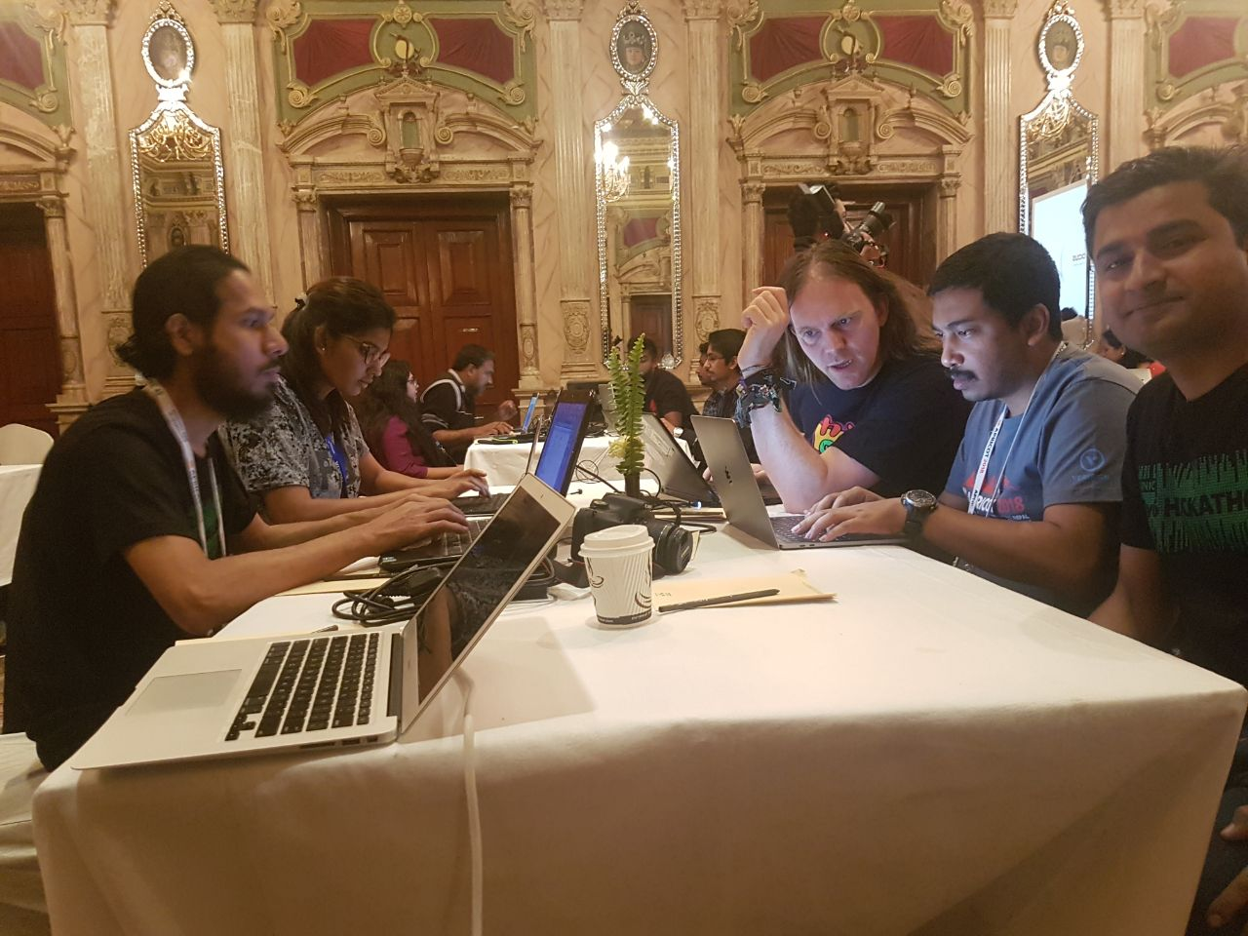
PICTURES

Slide 10
Team Poke Prefix
Concept by: George Michaelson: ggm@apnic.net
Implementation:
Amrita Nair: amritaanair98@gmail.com
Arnd: pokeprefix@schroedingers.cat
Krishna: pokhrel.krishna@gmail.com
Moin: moin@bofh.im
Jahidul: shamimcse02@gmail.com

Slide 11
https://apricot.bofh.network

